Slide 1

NYC property price prediction
Supervised Learning
By Gaukhar Javarova

Slide 2
Agenda
Introduction of the data.
The model building framework could be adjusted to build models for different markets.
Model specifications (chosen features)
Who are potential users of the model and why do they need to use it?
Model details

Slide 3
DATA
56.430 properties used for the research which were sold in NYC over 12-m. from 09/ 2016 - 09/2017
Data includes price, type of units, total square feet, location
Raw data can be found here: NYC-properties

Slide 4

The USA

Slide 5

Post - Soviet Union Countries

Slide 6

Bangladesh

Slide 7
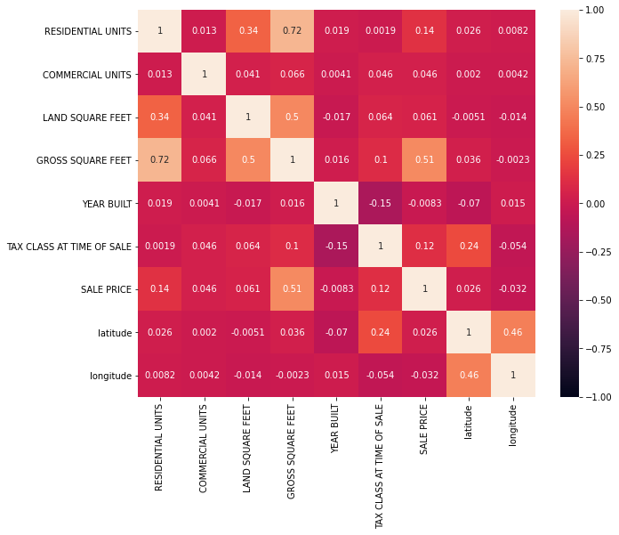
Properties Price prediction

Slide 8
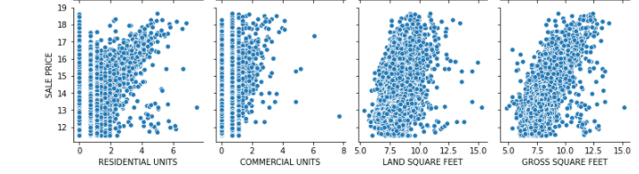
MODEL SPECIFICATIONS
SALE PRICE is correlated the most with LAND AND GROSS SQUARE FEETS
Residential Units have 0 commercial units.
Commercial Units have 0 residential units

Slide 9
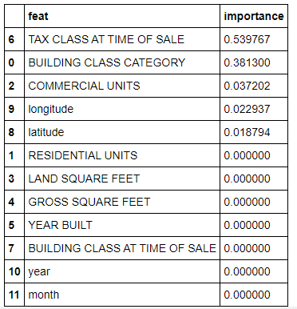
The most important features for this model predicting are TAX CLASS and BUILDING CLASS CATEGORIES

Slide 10
Who are the users?

Slide 11





Banks
Individual Investors
Real Estate Agencies
Hedge Funds
House flippers

Slide 12
Model details
MAE = On average the model's predictions are $651172.15 from the right answer
MAPE - On average the model's predictions are 40% from the right answer
Underpredicts very high-priced buildings
Had to be tuned for the user and be improved (taking into consideration categories like crime, colleges, demographics, school, governmental or commercial city)

Slide 13
Key takeaways:
This model framework can be tuned into any city's/country's Real Estate
Have an edge on predicting prices in rural areas for an investment
Great for countries where RE prices are not stable, people don’t know the real value.
RE investors can see the price difference in RE all around the world and choose the country to invest in.

Slide 14
Any questions?
THANK YOU!

